Slide 1



ONLINE LEARNING
Platform Analytics
Presented by Hager

Slide 2


PROJECT OVERVIEW
Analyze student engagement, course performance, feedback, and completion.
Use SQL Server as the main data source and organize the data for analytics.
Use Python/Jupyter Notebook for data loading, transformation, analysis, and visualizations.
Build an interactive Power BI dashboard for exploring the results.

Slide 3




DATA & ANALYTICS WORKFLOW
SQL Server Structured Data
Power Query
Cleaning & preparing the data
Python
Data analysis & visualizations
Power BI
Insights, filters & interactive visuals

Slide 4
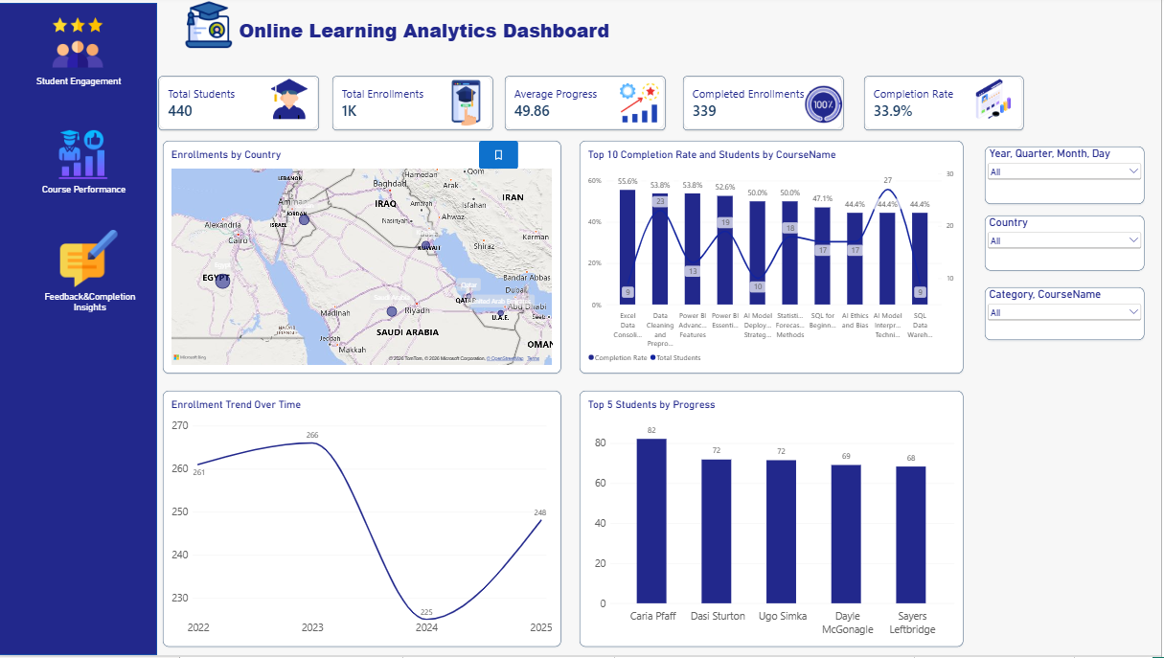
STUDENT ENGAGEMENT INSIGHTS
  Highest Enrollment Year: 2023 with 266 enrollments
  Highest Completion Rate: Excel Data Consolidation — 55.6%
  Top Student by Progress: Caria Pfaff — 82%.
  Top Progress Categories: Power BI and Data Analysis — about 52%.

Slide 5

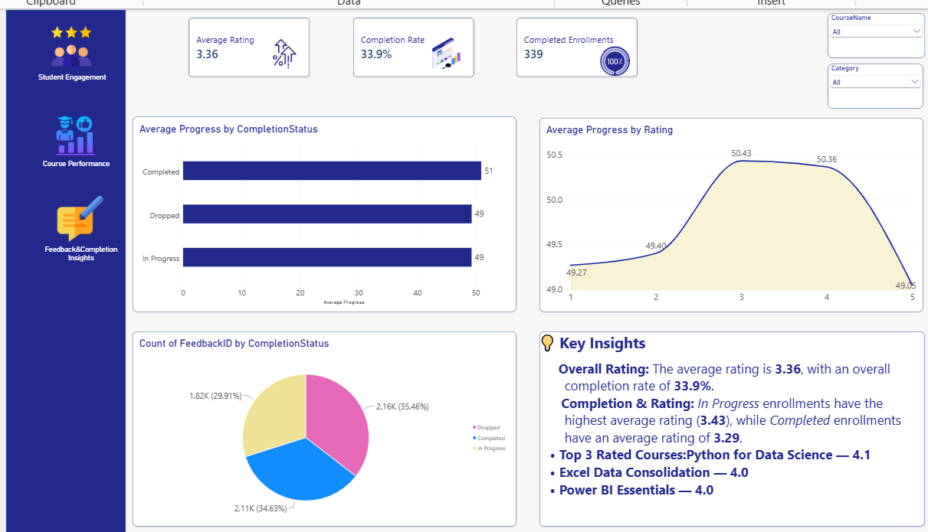
COURSE PERFORMANCE
  Highest Average Progress: Deep Learning Fundamentals — 58%.
  Other high-progress courses: Power BI Advanced Features and Natural Language Processing with Python — 56% each
  Longest Course: Data Analysis with Scikit-learn — 50 hours.
  Highest Course Rating: Python for Data Science — 4.07.

Slide 6
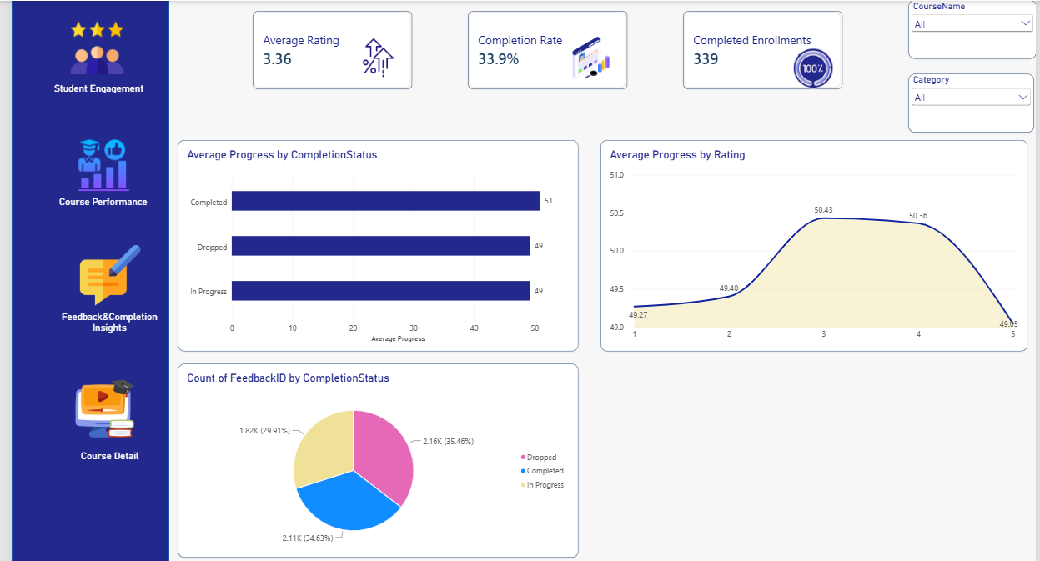
FEEDBACK & COMPLETION
  Highest Average Progress: Completed — 51%
  Highest Progress by Rating: Rating 3 — 50.43%
  Feedback Distribution: Dropped — 35.46%, Completed — 34.63%, In Progress — 29.91%
  Overall Rating: 3.36, with an overall completion rate of 33.9%

Slide 7

INSIGHTS
Overall Rating: The average rating is 3.36, with an overall completion
rate of 33.9%.
Completion & Rating: In Progress enrollments have the highest
average rating (3.43), while Completed enrollments have an average
rating of 3.29.
  Top 3 Rated Courses:Python for Data Science — 4.1
  Excel Data Consolidation — 4.0
  Power BI Essentials — 4.0

Slide 8
POWER BI DASHBOARD & CONCLUSION
🔹 Interactive Pages
Student Engagement
Course Performance
Feedback & Completion
🔹 Drillthrough
Course-level detailed analysis
🔹 Tooltips
Additional insights on hover
🔹 Slicers
Country & Category filters
🔹 Navigation & Bookmarks
Easy dashboard exploration

Slide 9
THANK YOU

